Slide 1

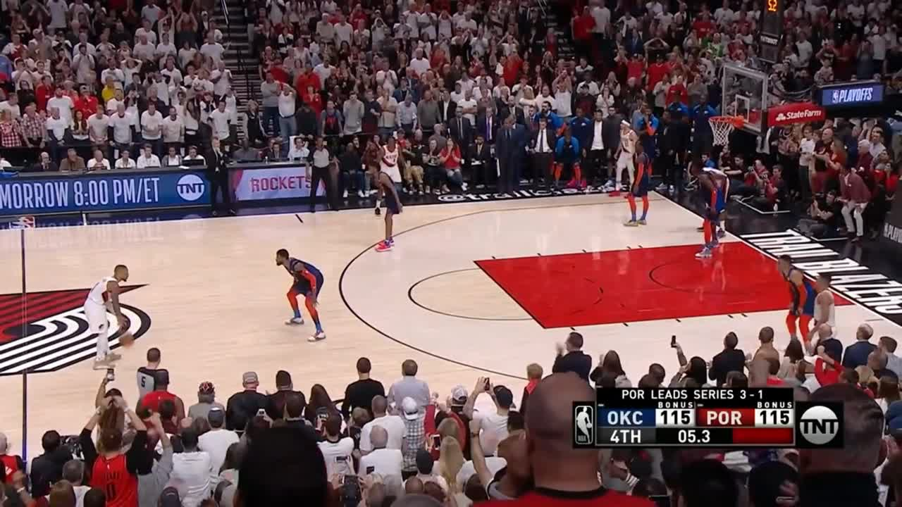

Slide 2
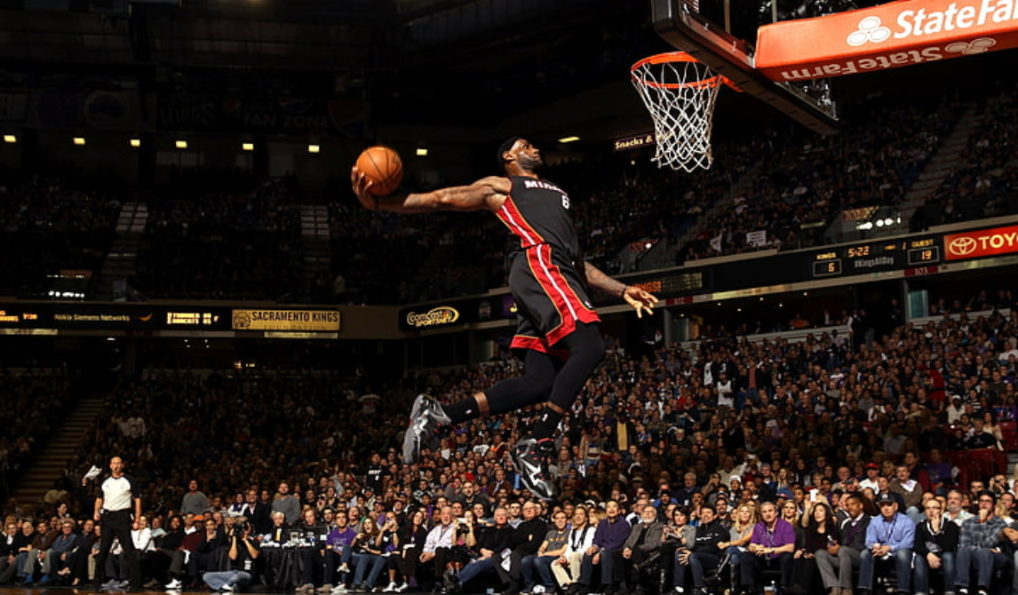
WHAT DRIVES NBA OFFENSE MORE?
SHOT CREATION
SHOT MAKING
BY ARTH ARUN, STEPHEN GAO, BRANDON HSI, JOSHUA EDWARDS,WESLEY LEE

Slide 3
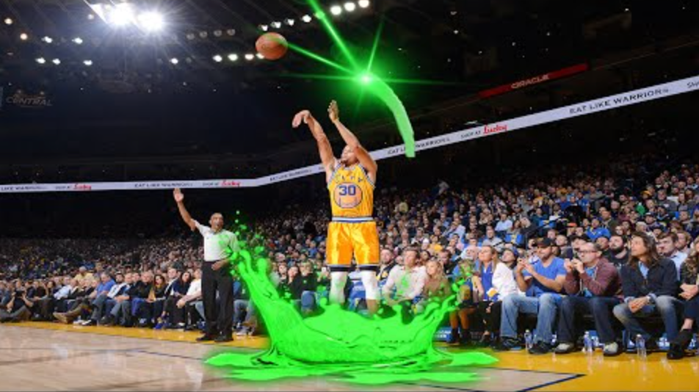
HYPOTHESIS
BACKGROUND INFO
Shot Creation has a greater association on offensive rating
NBA Seasons 2015-2025 (330 Teams)
Success measure: Offensive Rating
Independent Variables: Shot Creation and Shot Making
Shot Creation: Opportunity before the ball is released
Shot Making: Opportunity after the ball is released

Slide 4

NBA DATA TO MODEL
1) COLLECT
NBA StatsAPI & Shot Maps
(2015-2025)
2) ORGANIZE
One big Dataset with one row per Team Season(330)
4) TEST
Predict O-Rating
using two Linear Regression Models(OLS)
3) ANALYZE METRICS
Shot Creation, Shot Making & Shooting Stats

Slide 5
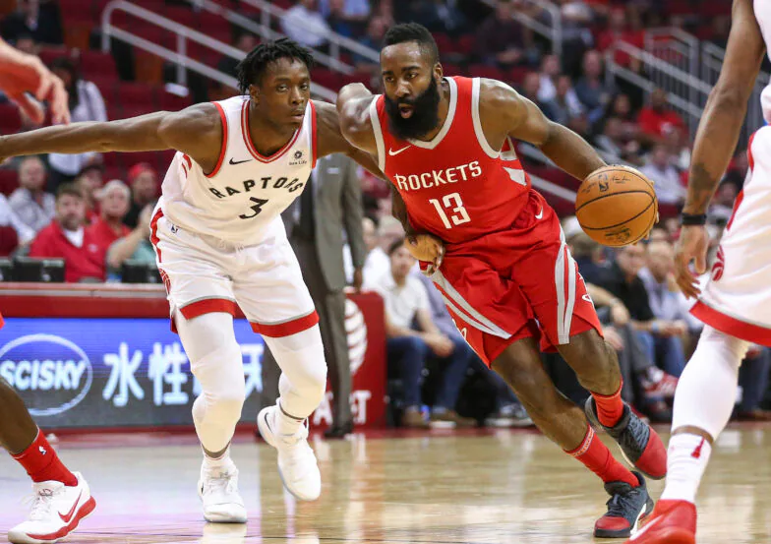
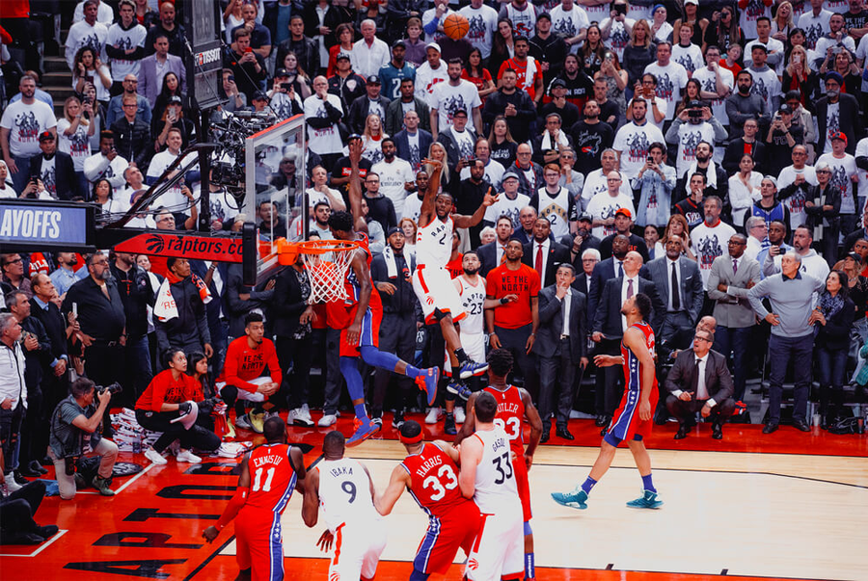
SHOT CREATION
SHOT MAKING
What quality of opportunities did the offense produce?(Before)
How well did the team convert its opportunities?(After)
ASSOCIATION

Slide 6
SHOT CREATION CONSTRUCTION
THE EQUATION
SHOT CREATION = Z(Rim Rate) + Z(Corner Three Rate) + Z(Wide Open Rate) − Z(Bad Shot Rate)
POSITIVE COMPONENTS
Rim Rate = Restricted-Area Attempts / Total Tracked Attempts
Corner 3 Rate = Corner Three Attempts / Total Tracked Attempts
Wide-Open Rate = Attempts with the nearest defender 6+ feet away / Total Tracked Attempts
NEGATIVE COMPONENTS
Bad Shot Rate = (Midrange Rate + Contested Rate) / 2
Midrange Rate = Midrange Attempts / Total Tracked Attempts
Contested Rate = Attempts with a Defender within 4 feet/Total Tracked Attempts

Slide 7
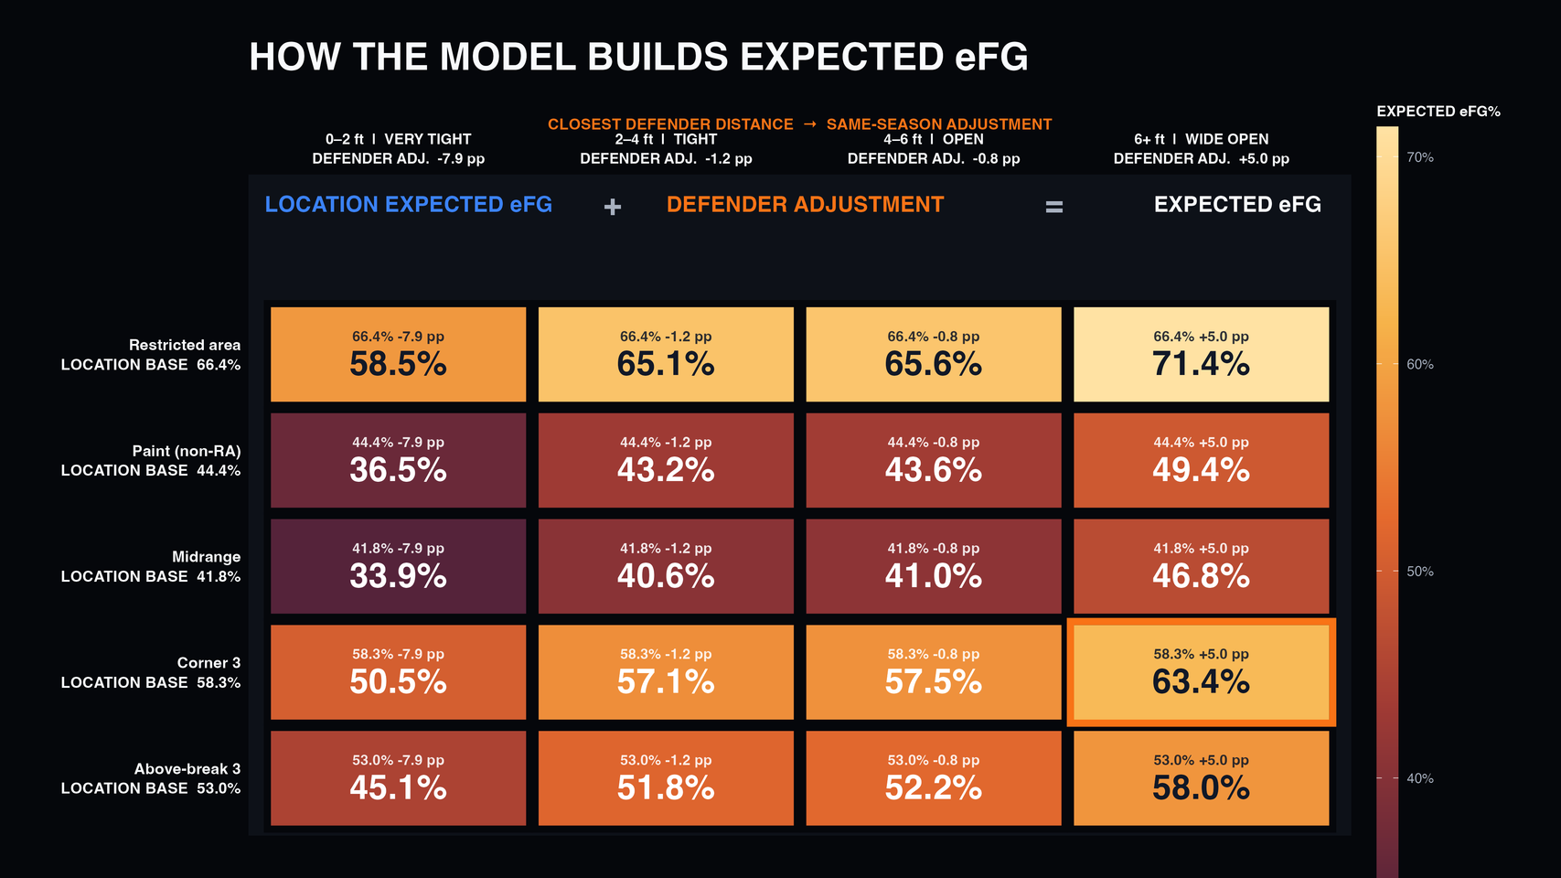
SHOT MAKING CONSTRUCTION
STEP 2:
STEP 3:
SHOT MAKING = 100(ACTUAL EFG - EXPECTED EFG) IN %PTS
STEP 1:
EXPECTED EFG = LOCATION EXPECTED EFG + DEFENDER ADJUSTMENT

Slide 8
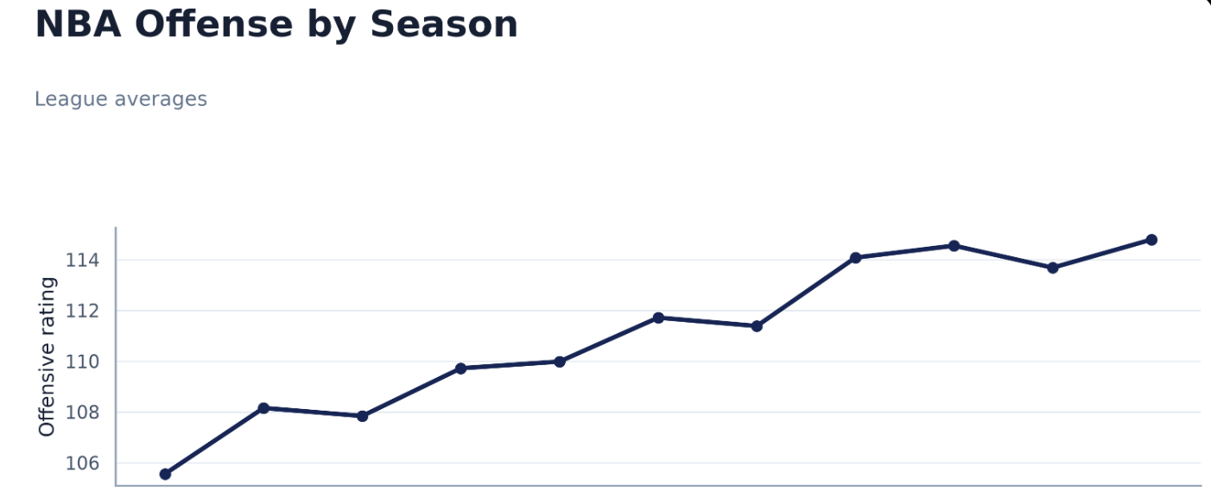
NBA OFFENSE CHANGED ACROSS ERAS
Season Fixed Effects
2016 <-> 2016
2025 <-> 2025
Own ORtg baseline per season
Teams compared in same season
114.8
+9.2 O-rating pts
114.8
105.6
2015-2016 SEASON TO 2025-2026 SEASON
105.6

Slide 9
REGRESSION ANALYSIS
Model 1:
Model 2:
ORtg = X₀ + X₁Z(Creation) + X₂Z(Making) + Season + ε
ORtg = X₀ + x₁Z(Creation) + x₂Z(Making) + x₃Z(TOV%) + x₄Z(ORB%) + x₅Z(FTr) + Season + ε
Question: Which shooting skill has the stronger within-season association with Offensive Rating?
Predictors: Shot Creation, Shot Making and season basline data.
Coefficients(x_n): represents strength between independent variable and O-rating
Question: Does the result remain after accounting for other major offensive factors(controll)?
Additional controls: Turnover rate, offensive rebound rate and free-throw rate.
X_0: The predicted ORtg for a 2015–16 team with average Shot Creation and average Shot Making.
*OLS model predicts intercept and coeffecients by minimizing the sum of the squared error of the residual of O-rating

Slide 10
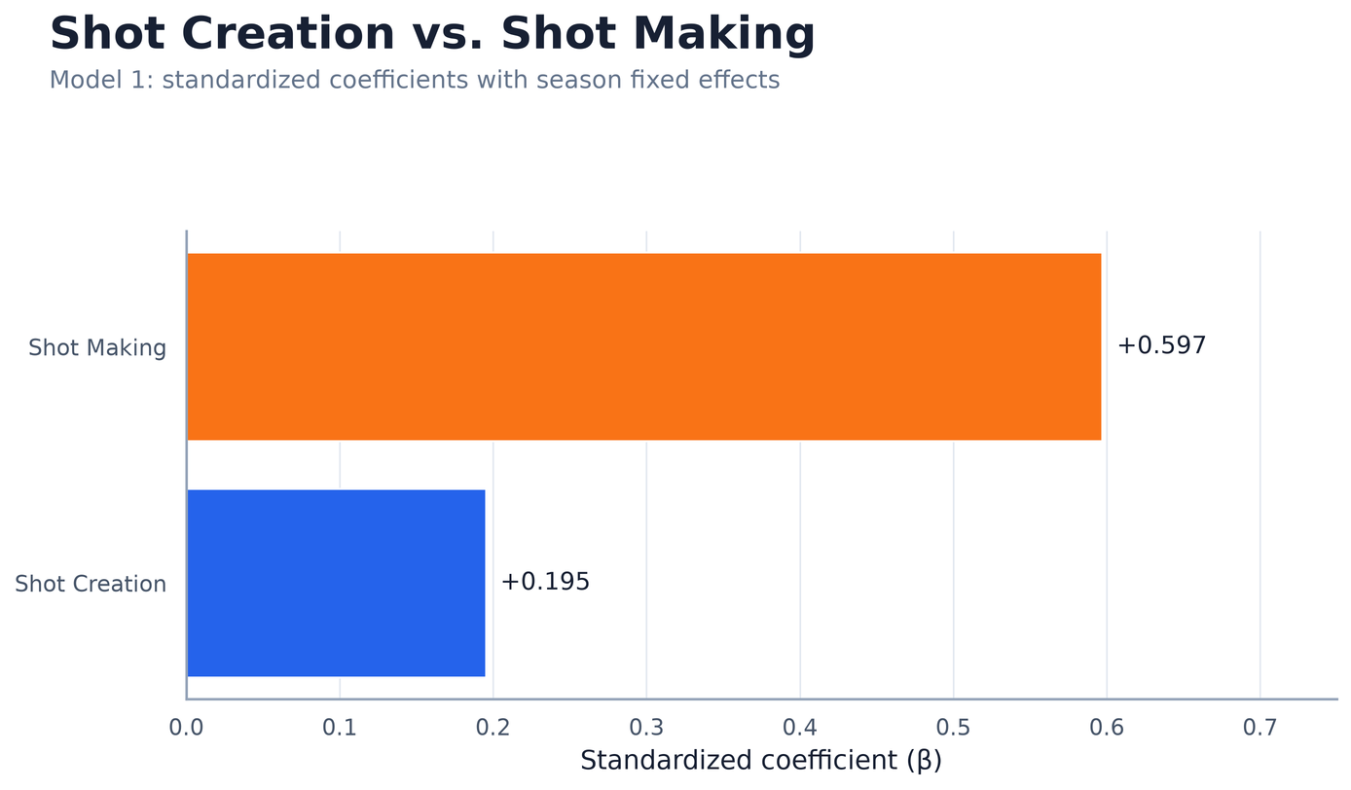
SHOT MAKING HAS THE STRONGER ASSOCIATION IN M1
Shot Making’s coefficient was about 3.1× larger
A one-standard-deviation increase in Shot Making was associated with a 0.597-standard-deviation increase in Offensive Rating, holding Shot Creation and season constant.

Slide 11
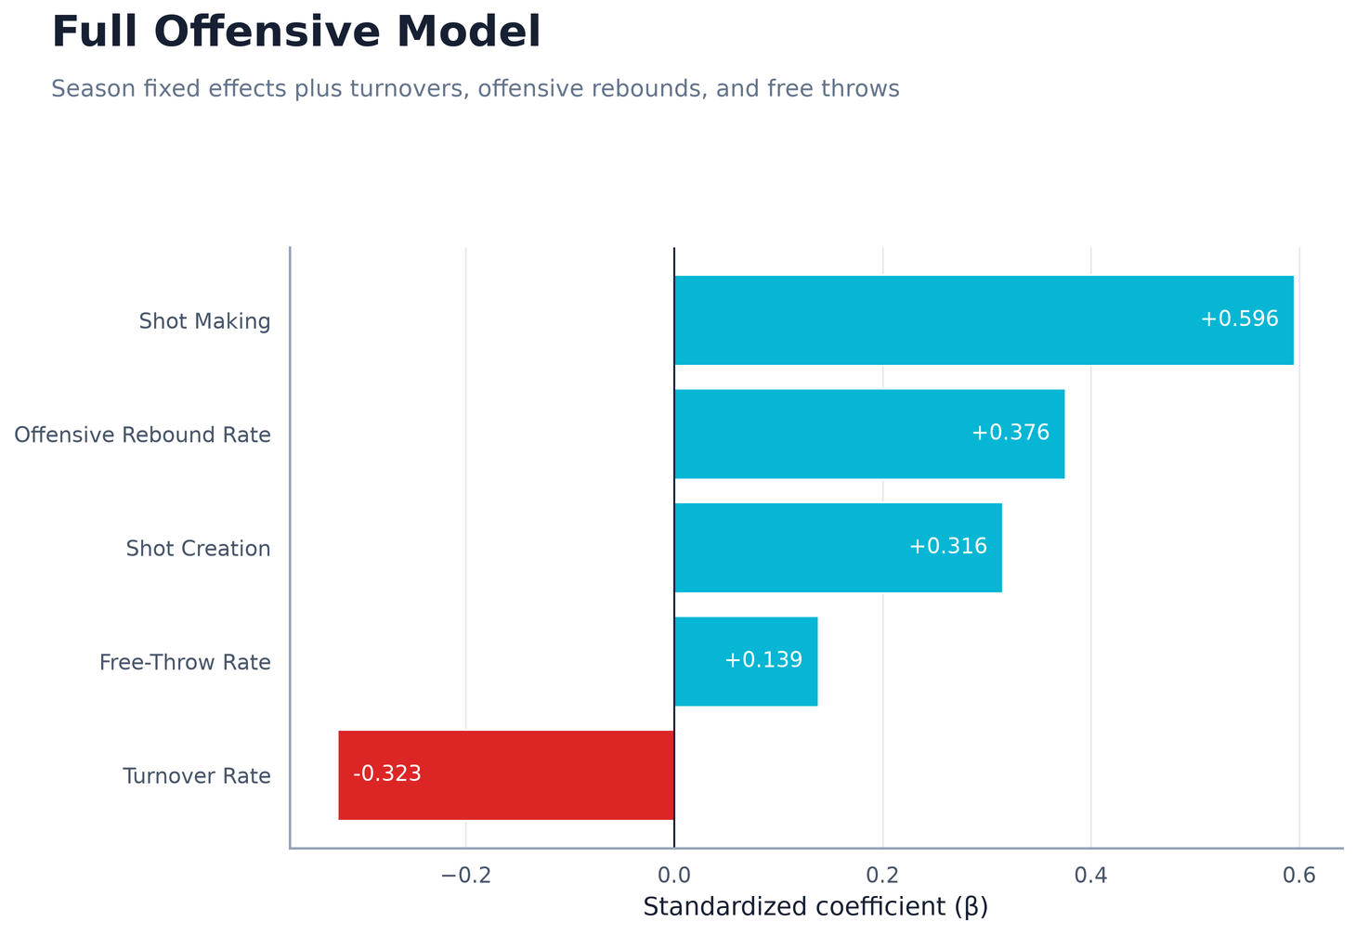
SHOT MAKING REMAINS STRONGEST AFTER CONTROLS IN M2
Shot Making: 0.597 to 0.596 after controlling
Shot Creation: 0.195 to 0.316 after controlling
WHY?: M2 exposes control variables separately to shot creation while M1 mixed factors to create score

Slide 12
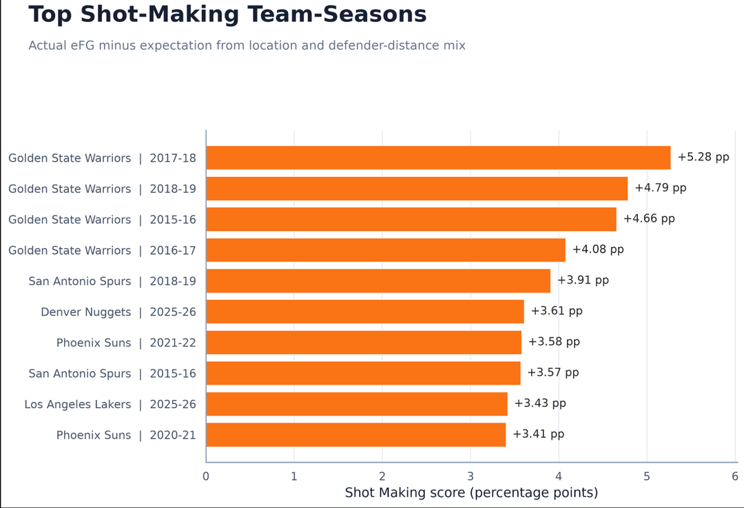
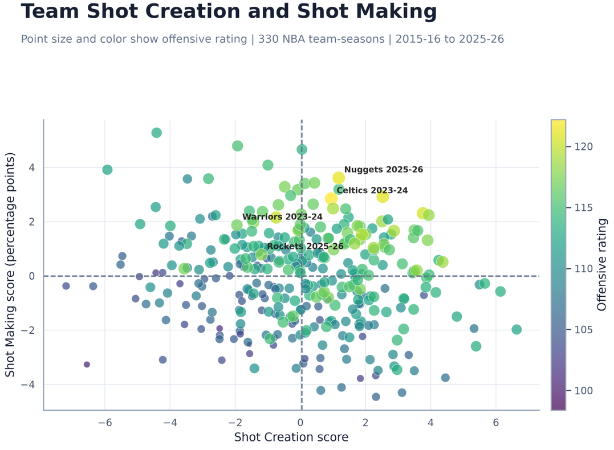
WHO BEAT OFFENSIVE EXPECTATIONS
Top Shot Making Team Seasons(%pts)
Team Shot Creation + Shot Making

Slide 13
Dashboard

Slide 14
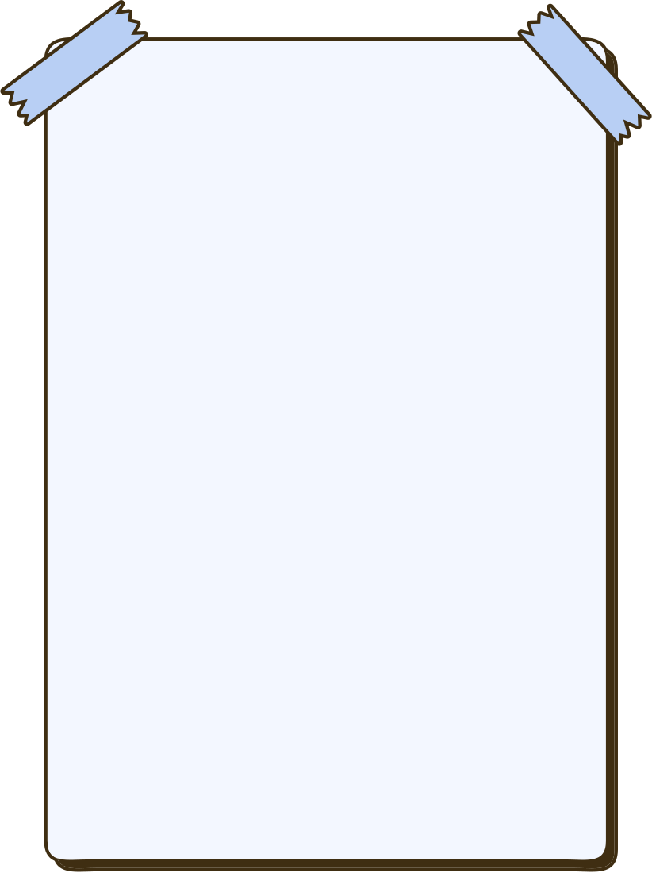






EXPERT INTEREST AND VALIDATION
Sameer Deshpande
Luke Bornn
Tyler Skinner
statistician whose research develops advanced Bayesian methods to analyze sports, with influential work in basketball, baseball, and football analytics.
Former Harvard Assistand Professor of Statistics, VP of Strategy and Analytics for the Kings. Specialzies in player tracking data and ML in soccer and basketball.
Assistant Professor of Sport Management at the University of South Carolina. Specializes in sports analytics, sports economics, and leadership.

Slide 15
LIMITATIONS
1. Custom metric: Shot Creation is an equal-weight index, not an official NBA metric.
2. Aggregated data: location and defender distance are separate team-season tables, not shot-level data.
3. Mechanical relationship: Shot Making uses eFG%, which is directly connected to points per possession.
4. Observational design: coefficients show associations, not causal effects.
5. Unobserved team differences: season fixed effects included, team fixed effects are not.

Slide 16


THANK YOU FOR LISTENING

Slide 17
THE RESULT IS STABLE ACROSS MODEL CHOICES
Shot Making had the larger coefficient in 38 of 40 sensitivity specifications.
Location-only expectation: 19 of 20
Location + defender expectation: 19 of 20
All specifications: 38 of 40
38 OF 40

Slide 18
APPENDIX: COMPLETE FORMULA REFERENCE I
Shot Location & Defender Rates
Rim Rate = Restricted-Area FGA / Total FGA
Corner3 Rate = Corner3 FGA / Total FGA
Midrange Rate = Midrange FGA / Total FGA
Wide Open Rate = WideOpen FGA / Defender Total
Contested Rate = (VeryTight FGA + Tight FGA) / Defender Total
BadShot Rate = (Midrange Rate + Contested Rate) / 2
Location Expected eFG%
Location Expected eFG% = Σ (team zone frequency × season league-average zone eFG%)
League Zone eFG%
League zone eFG%(Three-Point Zones) = League zone FG% × 1.5
League zone eFG%(Two-Point Zones) = League zone FG%
Z-score & Shot Creation Score
Z(x) = (x − mean(x)) / SD(x)
Shot Creation Score = Z(Rim Rate) + Z(Corner 3 Rate) + Z(Wide-Open Rate) − Z(Bad-Shot Rate)

